Slide 1
Region based Segmentation

Slide 2
Region Growing
5 | 6 | 6 | 6 | 7 | 7 | 6 | 6
6 | 7 | 6 | 7 | 5 | 5 | 4 | 7
6 | 6 | 4 | 4 | 3 | 2 | 5 | 6
5 | 4 | 5 | 4 | 2 | 3 | 4 | 6
0 | 3 | 2 | 3 | 3 | 2 | 4 | 7
0 | 0 | 0 | 0 | 2 | 2 | 5 | 6
1 | 1 | 0 | 1 | 0 | 3 | 4 | 4
1 | 0 | 1 | 0 | 2 | 3 | 5 | 4

Slide 3

Region Growing
$max⁡\{g\left(x,y\right)\} −min⁡\{g\left(x,y\right)\}$ <= 3
5 | 6 | 6 | 6 | 7 | 7 | 6 | 6
6 | 7 | 6 | 7 | 5 | 5 | 4 | 7
6 | 6 | 4 | 4 | 3 | 2 | 5 | 6
5 | 4 | 5 | 4 | 2 | 3 | 4 | 6
0 | 3 | 2 | 3 | 3 | 2 | 4 | 7
0 | 0 | 0 | 0 | 2 | 2 | 5 | 6
1 | 1 | 0 | 1 | 0 | 3 | 4 | 4
1 | 0 | 1 | 0 | 2 | 3 | 5 | 4

Slide 4

Region splitting
5 | 6 | 6 | 6 | 7 | 7 | 6 | 6
6 | 7 | 6 | 7 | 5 | 5 | 4 | 7
6 | 6 | 4 | 4 | 3 | 2 | 5 | 6
5 | 4 | 5 | 4 | 2 | 3 | 4 | 6
0 | 3 | 2 | 3 | 3 | 2 | 4 | 7
0 | 0 | 0 | 0 | 2 | 2 | 5 | 6
1 | 1 | 0 | 1 | 0 | 3 | 4 | 4
1 | 0 | 1 | 0 | 2 | 3 | 5 | 4
R1
R2
R3
R4
$max⁡\{g\left(x,y\right)\} −min⁡\{g\left(x,y\right)\}$ <= 3

Slide 5
Region Splitting
R1 and R3 satisfy homogeneity condition means all pixels in R1 satisfy threshold <=3 condition.
R1 is 7 – 4 = 3
R2 is 7 – 2 = 5
R3 is 3 – 0 = 3
R4 is 7 – 0 = 7

Slide 6
Region Splitting
5 | 6 | 6 | 6 | 7 | 7 | 6 | 6
6 | 7 | 6 | 7 | 5 | 5 | 4 | 7
6 | 6 | 4 | 4 | 3 | 2 | 5 | 6
5 | 4 | 5 | 4 | 2 | 3 | 4 | 6
0 | 3 | 2 | 3 | 3 | 2 | 4 | 7
0 | 0 | 0 | 0 | 2 | 2 | 5 | 6
1 | 1 | 0 | 1 | 0 | 3 | 4 | 4
1 | 0 | 1 | 0 | 2 | 3 | 5 | 4
R2
R1
R3
R4
Final Answer of Region splitting

Slide 7

Region Merging
$max⁡\{g\left(x,y\right)\} −min⁡\{g\left(x,y\right)\}$ <= 3
5 | 6 | 6 | 6 | 7 | 7 | 6 | 6
6 | 7 | 6 | 7 | 5 | 5 | 4 | 7
6 | 6 | 4 | 4 | 3 | 2 | 5 | 6
5 | 4 | 5 | 4 | 2 | 3 | 4 | 6
0 | 3 | 2 | 3 | 3 | 2 | 4 | 7
0 | 0 | 0 | 0 | 2 | 2 | 5 | 6
1 | 1 | 0 | 1 | 0 | 3 | 4 | 4
1 | 0 | 1 | 0 | 2 | 3 | 5 | 4

Slide 8
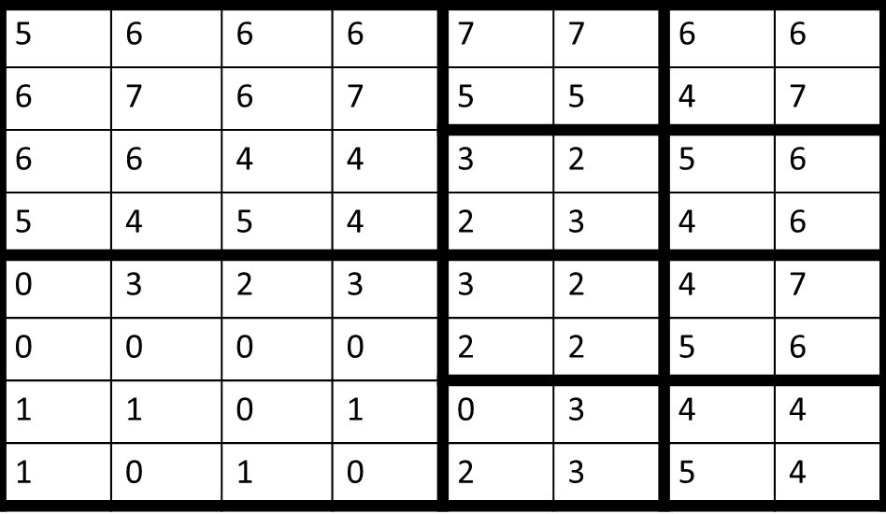
Region Merging
Check for four adjacent homogeneous regions
Image after step 1

Slide 9
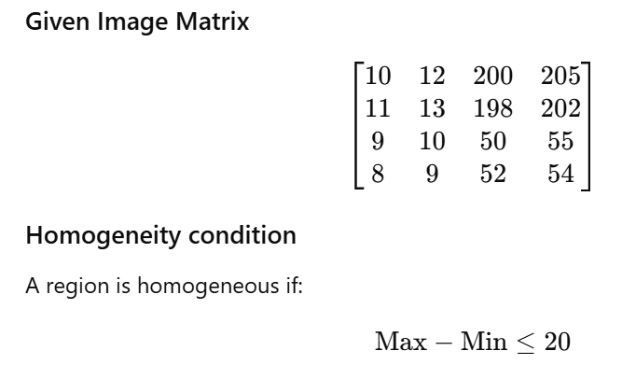
Region Split and Merge

Slide 10
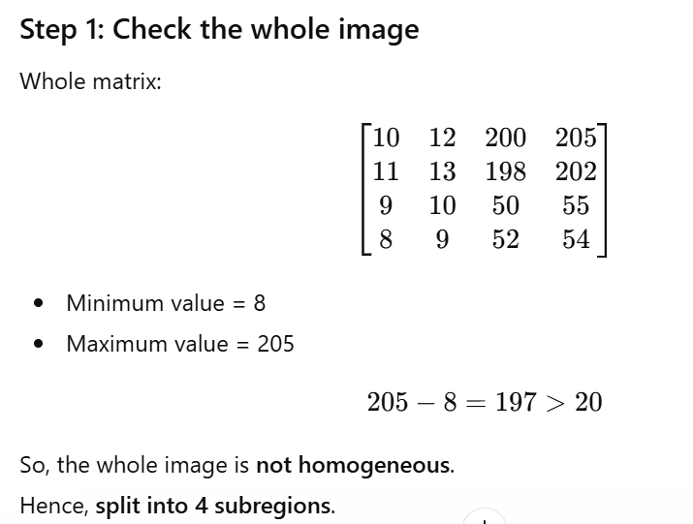

Slide 11
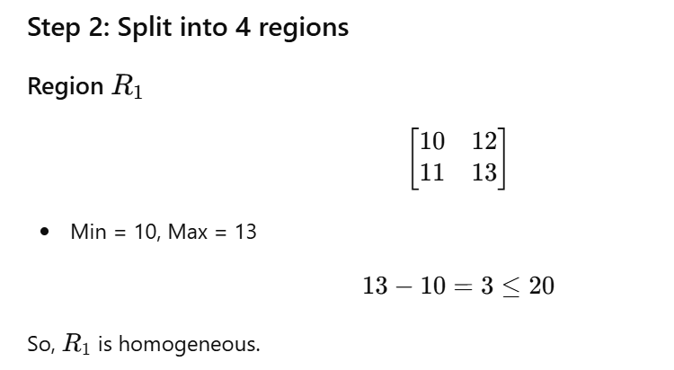

Slide 12
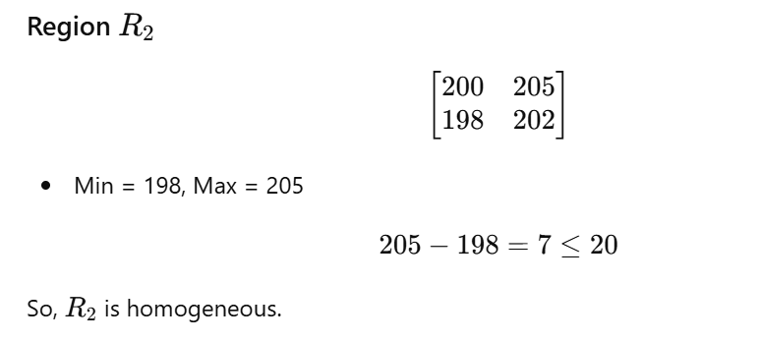

Slide 13
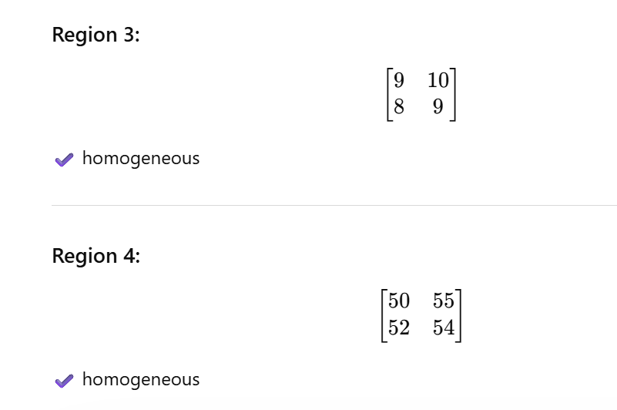

Slide 14
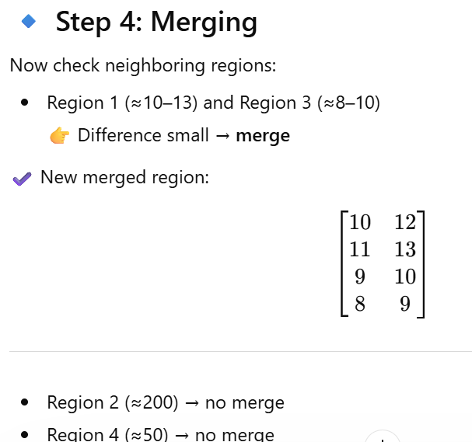

Slide 15
10 | 12 | 200 | 205
11 | 13 | 198 | 202
9 | 10 | 50 | 55
8 | 9 | 52 | 54

